Slide 1
Player Spotlight: Kristie Ahn

Slide 2
Kristie Ahn
Reached the Rd of 16 of the 2019 US Open
Highest WTA singles ranking of #87
University of Stanford graduate
First Asian American woman to reach the rd. of 16 since Lilia Osterloh in 2000
All American and Rookie of the year at Stanford University

Slide 3
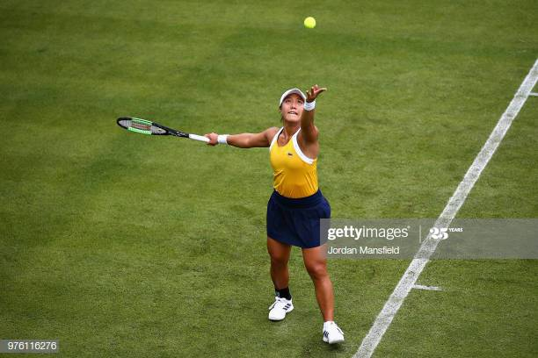
Interview Questions
2019 US Open run?
The life of a student/athlete?
The journey to a break-through?
Tune in to get your questions answered!!!

